Slide 1
CRAIGSLIST Price predictions a DATA science APPROACH bY: dEVIN KESTELL, 10/29/2024

Slide 2
AGENDA
Problem
EDA
Data Processing and Feature Engineering
Modeling 1-4
How to use the model?
Conclusion
Future Work

Slide 3

PROBLEM definition
He was always huddled over his cathode ray tube PC paging through ads
With 463k+ car ads from Craigslist, can we successfully predict ad prices?
Why? Car flippers, need to find good deals fast.

Slide 4
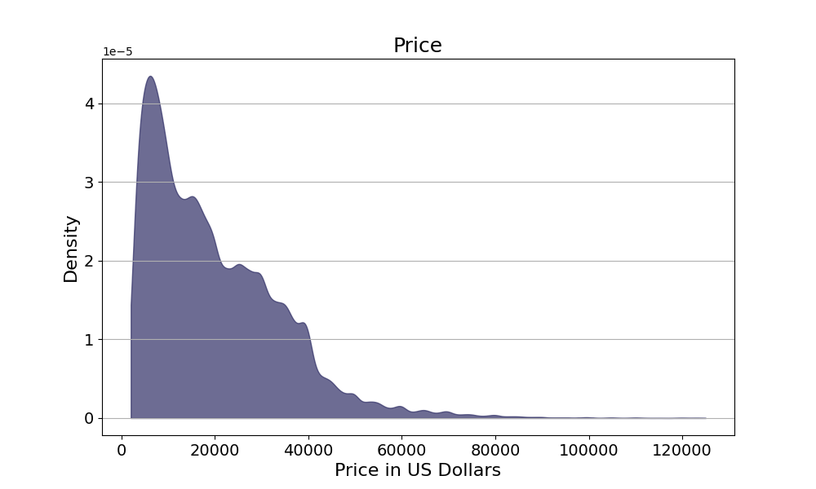
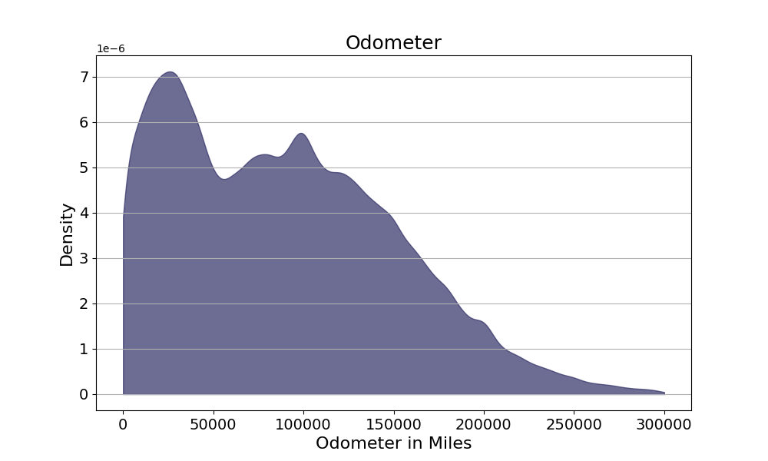
EDA
Our target variable and mileage are both right skewed while price has 5% of values at 0.

Slide 5
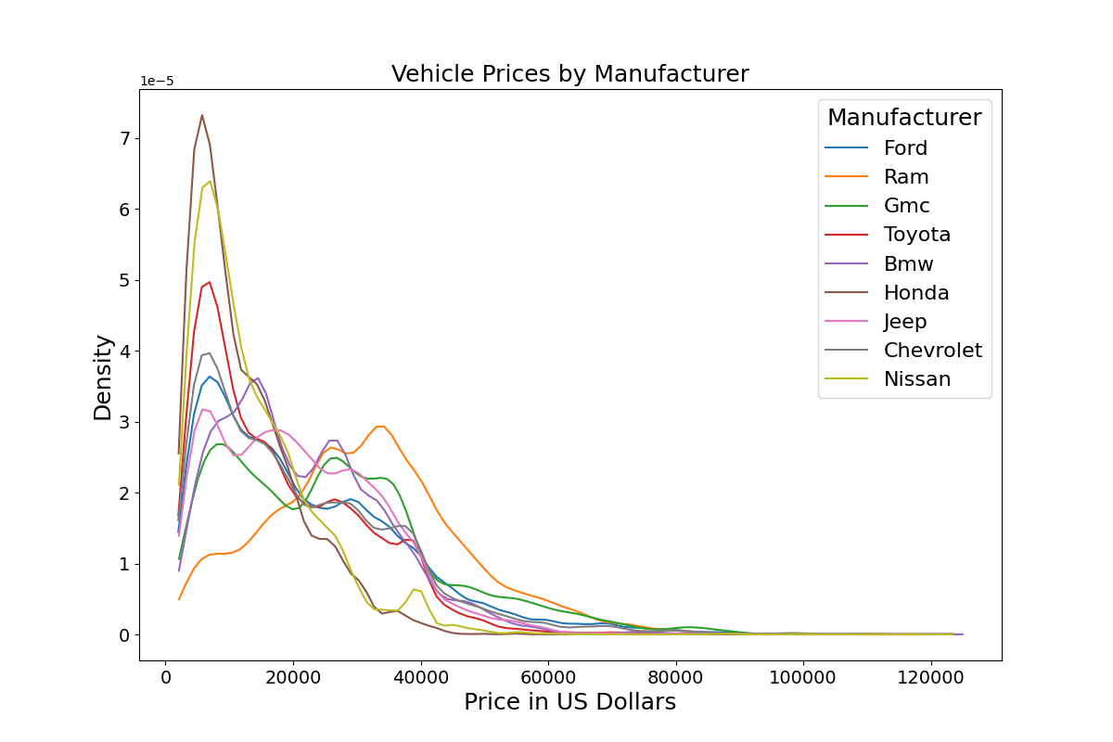
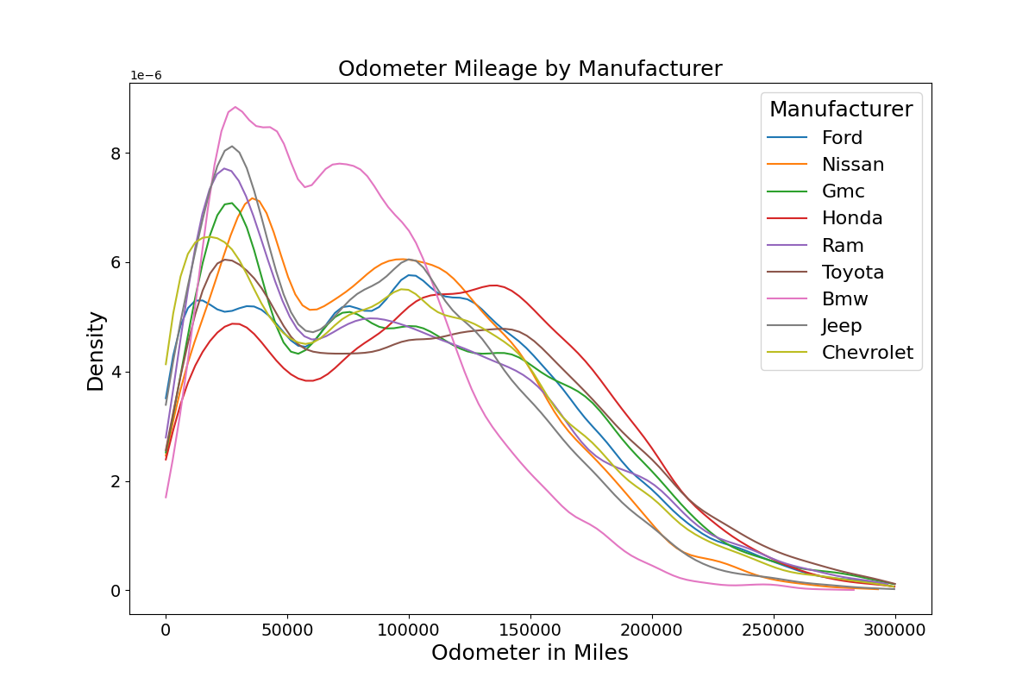
EDA
It does seem to change by manufacturer, note BMW and Ram.

Slide 6
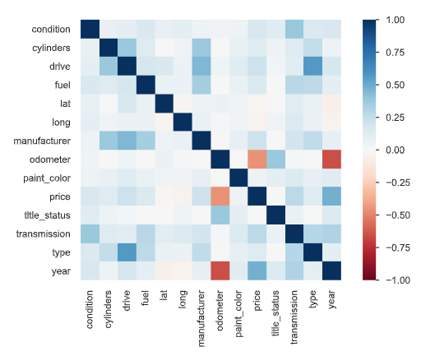
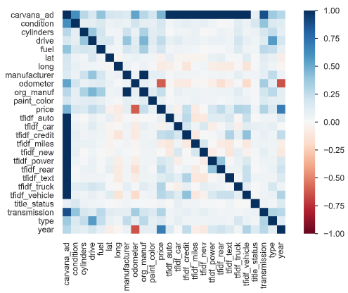
EDA
Correlations before and after data cleaning and feature engineering

Slide 7
Data processing and feature engineering
Change | Rows Affected (%)
Drop impossible Odometer and Price | 53k (12%)
Deduplicate Values | 24k (6%)
Drop useless columns
Remove stop words from description
Create TF_IDF columns
Dwarf, Love, Curse, Cottages, Music
TF(Dwarf)
= 2 / 5
TF- Term Frequency
# specific word / total words
Snow White and the 7 Dwarves,
Sleeping Beauty,
Rapunzel
IDF(Dwarf)
= Log(3/1)
IDF – Inverse Document Frequency
log(number of documents containing term/ total number of documents )

Slide 8
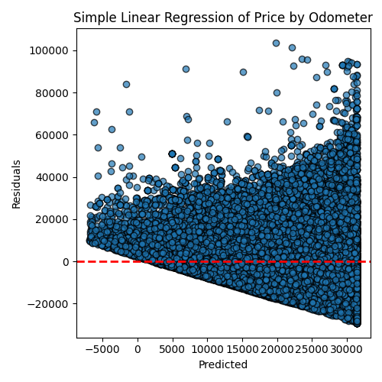
Model one
Simple Linear Regression Price ~ Odometer
Pros: Very Fast and Interpretable
Average car price starts at 31k
Decrease $127 for each 1k miles driven
Cons: Untrustworthy and Inaccurate
Off by $12k (RMSE) on average
Assumptions don't hold

Slide 9
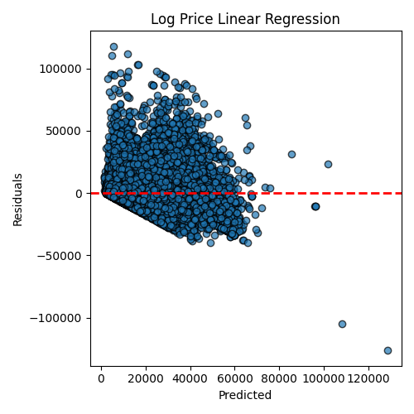
Model Two
Multiple Linear Regression Log(Price) ~ year + manufacturer + state + title status + paint color
Pros: Very Fast
Trains in less than a second
Now off by only $11k on average
Cons: Untrustworthy, Inaccurate, Uninterpretable
80 terms
Assumptions don't hold

Slide 10
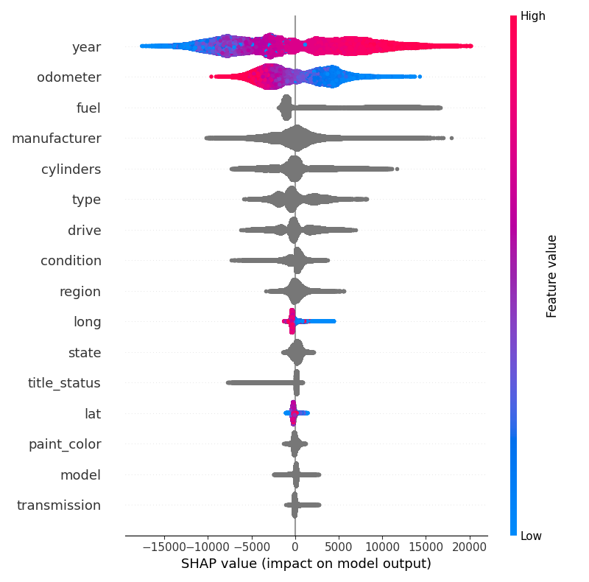
Model Three
Light GBM Price ~ All Basic Variable
Pros: More accurate
$6,200 RMSE,
Explains 81% of variability in price
Cons: Black Box, slower
Takes a few minutes to train
Have to use SHAP to understand the model

Slide 11
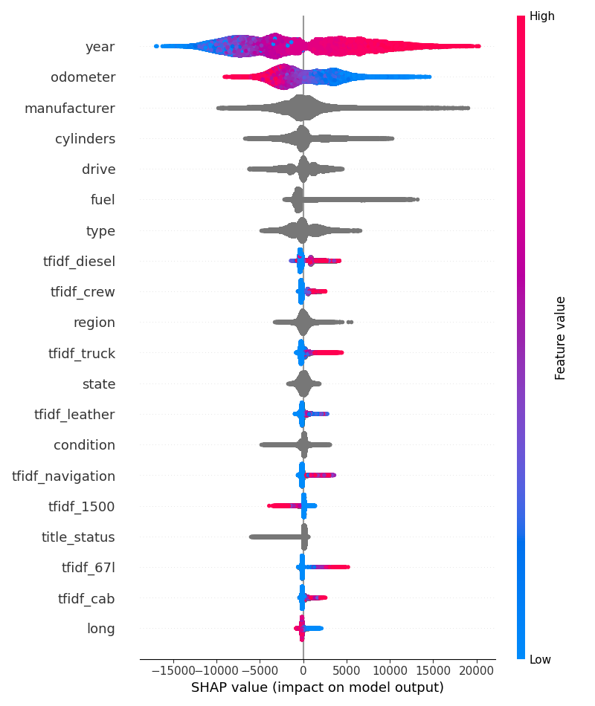
Model Four
Hyperparameter Tuned Light GBM Price ~ Basic Variable + Feature Engineered + Text Variables
Pros: Much more accurate
$5,400 RMSE,
Explains 86% of variability in price
Cons: Black Box, slower
Takes a few minutes to train
Three hours to hyperparameter tune
Have to use SHAP to understand the model

Slide 12
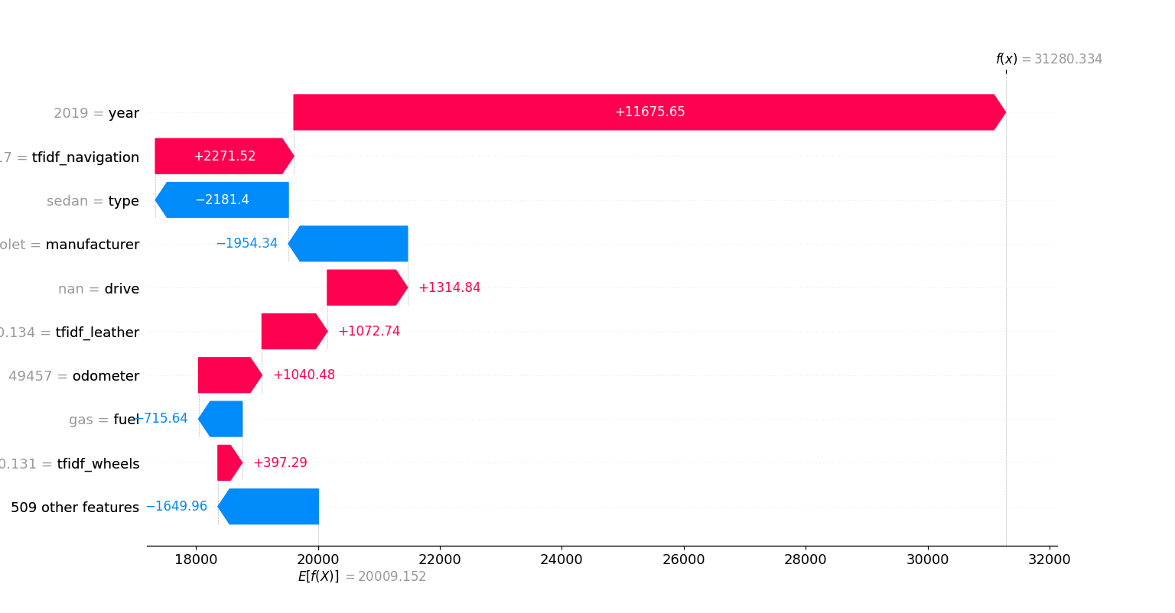
How to use the model?

Slide 13
Future improvements
Use Regex to "de-boilerplate" Carvana Ads
Use car images for CVML
Use cross validation in training and hyperparameter tuning
Add unit and integration tests
Use lat and long to extract Cost of Living

Slide 14
Conclusion
The final model, model four, takes a bit of time to train but predicts very fast. The model gave good predictions with an RMSE of $5,400. The most important variables are age, odometer, manufacturer, is the vehicle a truck and does it have luxury amenities.

